Slide 1

Geometry
Circle Applications

Slide 2
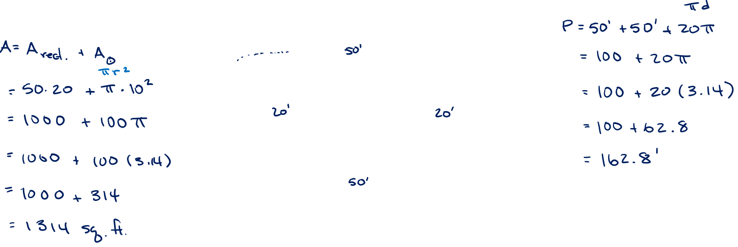
Skating Rink
A skating rink is made up of two semi-circular sections on the short ends of a 50’ x 20’ rectangle. What are the perimeter and surface area of the rink?

Slide 3
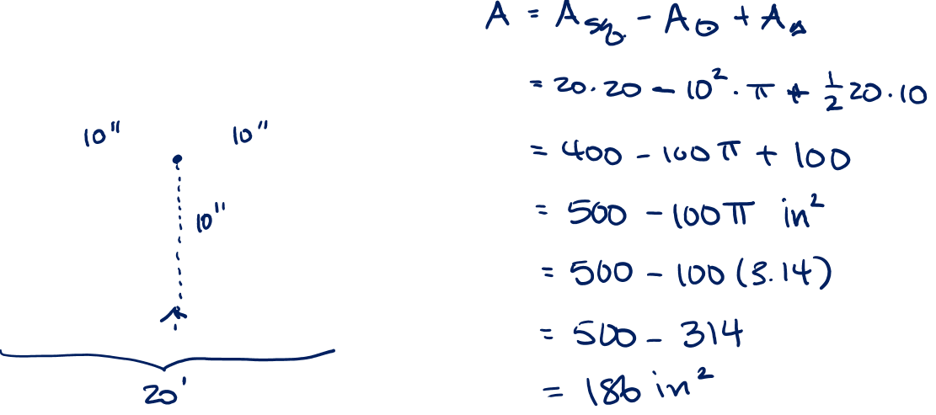
Shaded Areas
Find the shaded area if the circle is inscribed in the square, i.e. it just touches the square at the four edge points, and the triangle is a right triangle inscribed in the circle whose upper side passes through the center of the circle and if the radius of the circle is 10”.

Slide 4
What’s Next

