Slide 1
Systems of Inequalities
Systems of Linear Inequalities – Special Cases

Slide 2
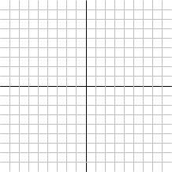
Systems of Linear Equations

Slide 3
Systems of Linear Equations

