Slide 1

Systems of Inequalities
Systems of Linear Inequalities

Slide 2
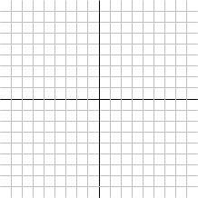
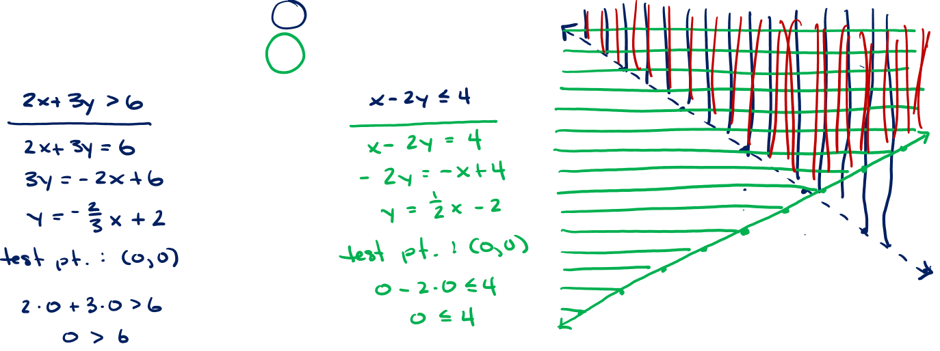
Systems of Linear Equations

