Slide 1
Relations
Inverses

Slide 2
Inverses
Let R be a relation from A to B. Define the inverse relation R⁻¹ from B to A by
R⁻¹ = {(y, x) ∈ B × A | (x, y) ∈ R}

Slide 3
Inverse Relations
a
b
c
a
b
c

Slide 4
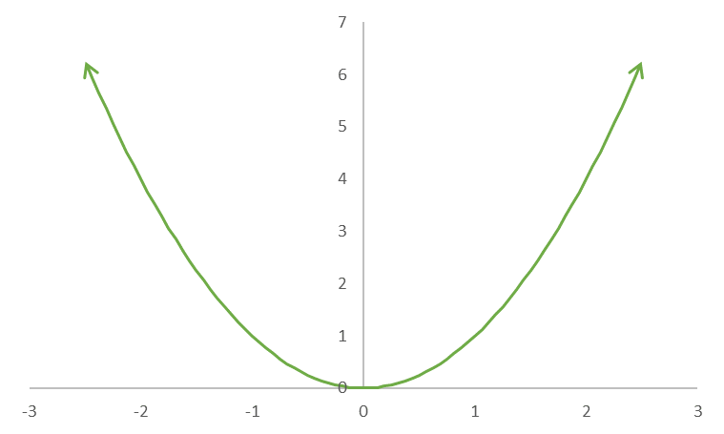
Inverses
Define the relation R from to by x R y if and only if y = x².

Slide 5
What's Next

