Slide 1
Sequences and Induction
Mathematical Induction

Slide 2
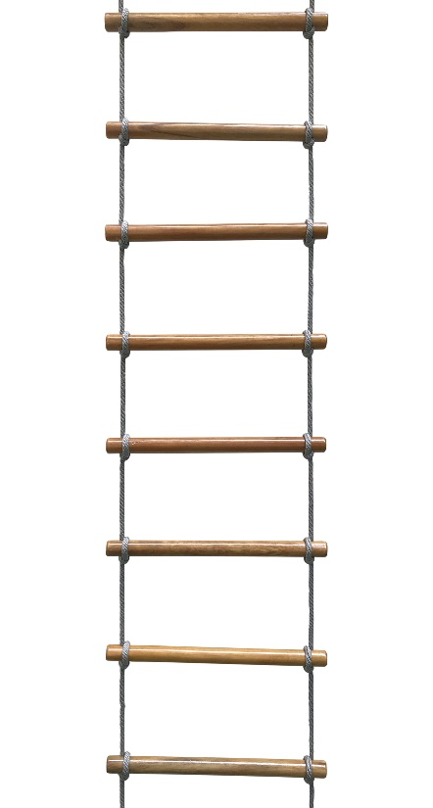
Mathematical Induction
You know you can reach the first rung.
If you can reach a rung you can always reach the next one.

Slide 3
Mathematical Induction
To prove that P(n) is true for all integers n ≥ a, complete two steps:
Prove that P(a) is true for some value, a.
Show that, if P(k) is true then P(k + 1).

Slide 4
Mathematical Induction

Slide 5
What's Next

