Slide 1
Quadratic Polynomials
Finding the Vertex

Slide 2
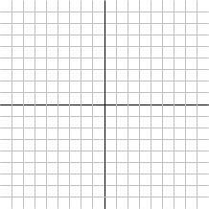
The Vertex of a Parabola

Slide 3
The Vertex of a Parabola

Slide 4
The Vertex Form

Slide 5
What's Next

