Slide 1
Limits and Continuity
Continuity Examples

Slide 2

Properties of Continuity
If f and g are continuous at x = c then the following functions are also continuous at x = c.
f + g
kf where k is a constant
f ⋅ g
f / g assuming g(c) ≠ 0
f ^{n} where n is a positive integer
where n is a positive integer and
the function is defined on an interval around c

Slide 3
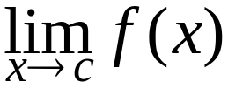
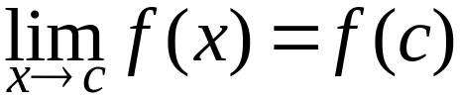
Continuity
A function f is continuous at x = c if and only if:
f(c) is defined.
exists.

Slide 4
Lemma – Continuity of Polynomials
All polynomials are continuous.

Slide 5
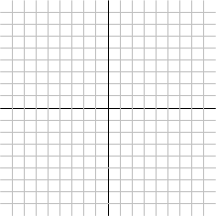


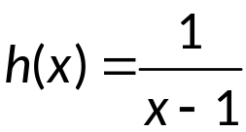
Example 1
A function f is continuous at x = c if and only if:
f(c) is defined.
exists.

Slide 6

Example 2
A function f is continuous at x = c if and only if:
f(c) is defined.
exists.

Slide 7
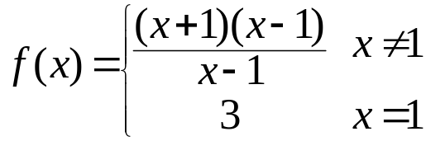
Example 3
A function f is continuous at x = c if and only if:
f(c) is defined.
exists.

Slide 8

Example 4
A function f is continuous at x = c if and only if:
f(c) is defined.
exists.

Slide 9
What's Next
Notes:
Discuss how this can be used to approximate roots.

