Slide 1
Limits and Continuity
Continuity

Slide 2
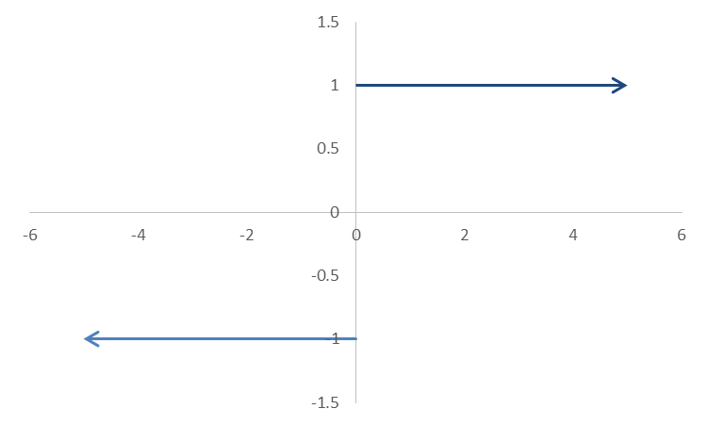
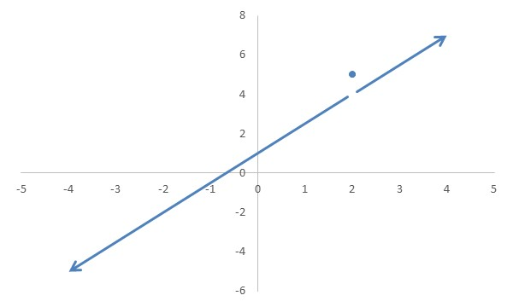
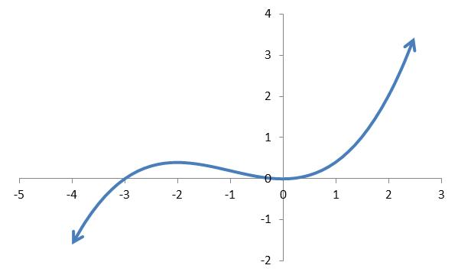
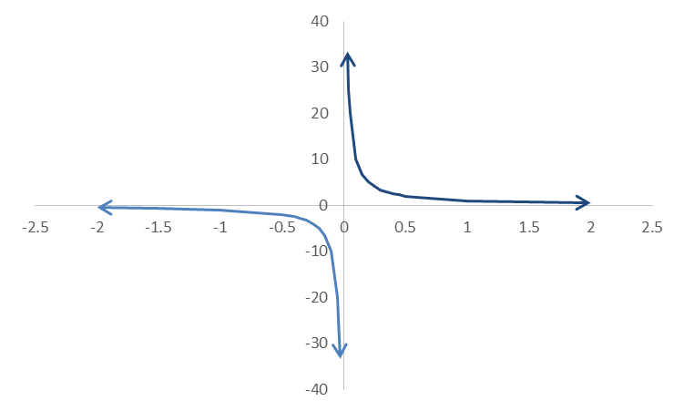
Graphs with Problems (and One without)

Slide 3
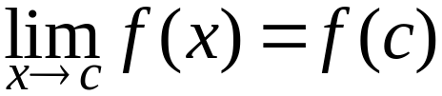
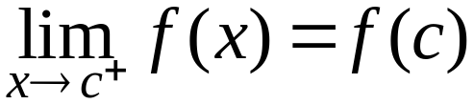
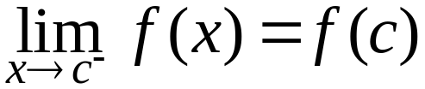
The Definition
A function f is continuous at x = c if and only if
A function f is right-continuous at x = c (or continuous from the right) if and only if
A function f is left-continuous at x = c (or continuous from the left) if and only if

Slide 4
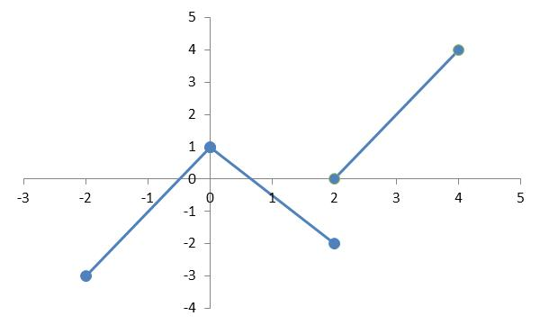
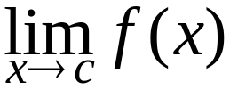
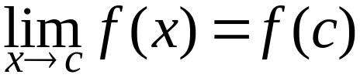
Applying the Definition
A function f is continuous at x = c if and only if:
f(c) is defined.
exists.

Slide 5
Continuity on Intervals
A function is continuous on an open interval if it's continuous at every point on the interval. A function is continuous on a closed interval, [a, b], if it's continuous on every point in the interior of the interval, left continuous at a and right continuous at b.

Slide 6
Continuous Functions
A continuous function is one that's continuous at every point in its domain. A function that's discontinuous at one ore more points of its domain is called discontinuous.

Slide 7
What's Next?

