Slide 1
Graphing Polynomials
Multiplicity

Slide 2
Multiplicity

Slide 3
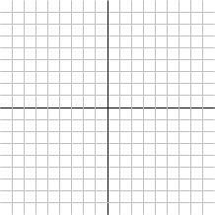
Multiplicity
f(x) = x – 1
f(x) = (x – 1)²

Slide 4
Multiplicity Rule
If a root has even multiplicity then the graph touches the axis at that point
If a root has odd multiplicity then the graph crosses the axis at that point.

Slide 5
Multiplicity
Give the multiplicity of each root and discuss the behavior of the graph at that point.
f(x) = (-2x + 1)⁴(x – 3)²(x – 1)

Slide 6
Multiplicity
Give the multiplicity of each root and discuss the behavior of the graph at that point.
f(x) = -3x³(4x + 1)⁶(-2x – 3)²(2x – 5)

