Slide 1
Graphing Polynomials
End Behavior

Slide 2
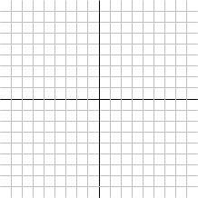
Graphing
End behavior
Roots
Multiplicity

Slide 3
"End Behavior"
End behavior
Roots
Multiplicity

Slide 4
"End Behavior"

Slide 5
Case I
f(x) = x² + 10x – 100
x | x² | 10x | 100 | x² + 10x – 100
1
10
100
1000
Notes:
1 1 10 100 -89
10 100 100 100 100
10000 1000 100 10,900
1000 1,000,000 10,000 100 1,009,900

Slide 6
Case II
f(x) = -x² + 10x – 100
x | -x² | 10x | 100 | -x² + 10x – 100
1
10
100
1000
Notes:
1 1 10 100 -91
10 100 100 100 -100
10000 1000 100 -9,100
1000 1,000,000 10,000 100 -990,100

Slide 7
Case III
f(x) = x³ + 10x – 100
x | x³ + 10x – 100
1
10
100
1000
Notes:
1 -89
10 1000
1,000,900
1000 1,000,009,900

Slide 8
Case III
f(x) = x³ + 10x – 100
x | x³ + 10x – 100
1
10
100
1000
x | x³ + 10x – 100
-1
-10
-100
-1000
Notes:
1 -91
10 -1000
-999,100
1000 -999,990,100

Slide 9
Case IV
f(x) = -x³ + 10x – 100
Notes:
1 -91
10 -1000
-999,100
1000 -999,990,100

Slide 10
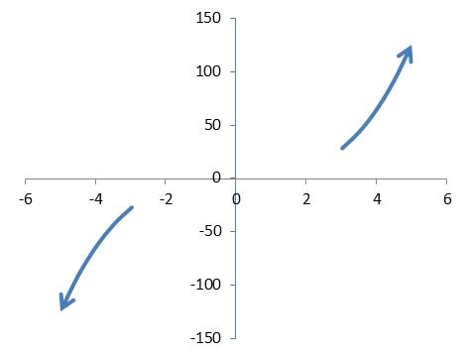
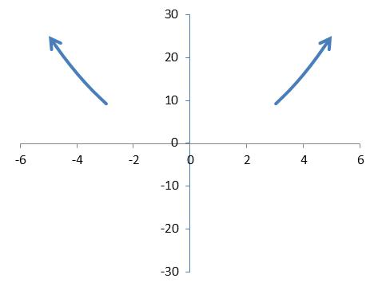
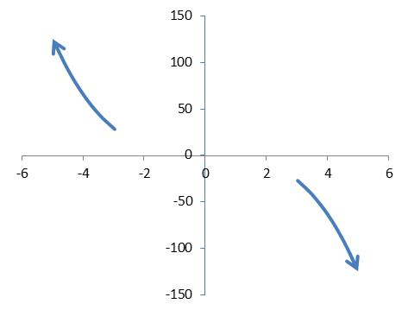
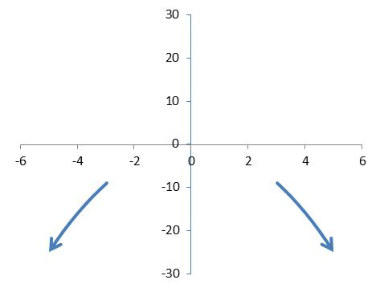
Four Cases
f(x) = a_{n}x^{n} + . . . + a₀
n odd, a_{n} > 0
n even, a_{n} > 0
n odd, a_{n} < 0
n even, a_{n} < 0

