Slide 1
Analytic Geometry
Parallel Lines

Slide 2
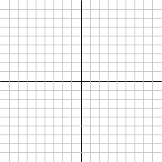
Parallel Lines
Notes:
What does it mean for two lines to be parallel? Geometry already has a definition: Two lines are parallel if and only if they both lie in a plane and they never cross. We need to come up with an algebra definition but it has to mean the same thing – we aren't looking to come up with a new concept, just an algebra-based way of defining the concept that we already have.
First, we don't have to worry about the, "in a plane part". Everything we're talking about takes place in the flat Cartesian plane. The part we really need to focus on is the never cross piece. Another way to think of "never cross" is "they're going in the same direction" and that's something we can describe algebraically. In algebra, the direction a line is going, up versus down, steep versus shallow, is defined by the slope. So we can say, using algebra terms, that two lines are parallel if their slopes are the same.
Unfortunately, that's not quite good enough. Think about this situation. [ ] The two lines are still going in the same direction but we definitely can't say that they still don't cross each other. So we have to add one more criterion to rule out this special case: We're also going to require that they're y-intercepts are different. Those two rules together are enough to guarantee that our algebra definition gives the same results as the geometry one.

Slide 3
Parallel Lines
Are the equations 3x + 4y + 2 = 0 and -6x – 8y = 1 parallel?

Slide 4
What’s Next

