Slide 1
Horizontal and Vertical Lines
Identifying and Writing Equations

Slide 2
Identifying Horizontal and Vertical Lines
x = 5 4x = 2y – 1 3 + 2 = y 3x + y = 4 + 3x

Slide 3
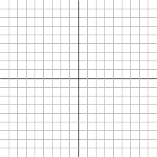
Finding the Equation of a Line
Find the equation of the line through the points (-3, 5) and (4, 5).

Slide 4
Finding the Equation of a Line
Find the equation of the line through the points (-3, 2) and (-3, 7).

