Slide 1
Horizontal and Vertical Lines
Slopes and Equations

Slide 2
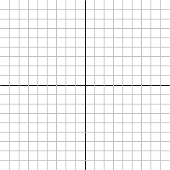
Horizontal Lines

Slide 3
Vertical Lines

