Slide 1
Linear Equations
Interpreting the Slope of a Line

Slide 2
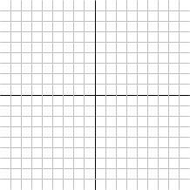
Interpreting the Slope of a Line
Find the slopes of the lines through the points (1, 1) and (6, 7) and through the points (1, 7) and (6, 1).
(6, 7)
(1, 7)
(1, 1)
(6, 1)

Slide 3
Interpreting the Slope of a Line
Find the slopes of the lines through the points (-1, -7) and (6, 7) and through the points (-7, 5) and (6, 7).
(6, 7)
(6, 7)
(-7, 5)
(-1, -7)

Slide 4
What’s Next

