Slide 1
Linear Equations
Finding Intercepts

Slide 2
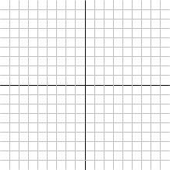
Intercepts
(0, y)
(x, 0)
Notes:
Intercept in math means the same as it does in English – it’s the point where two things cross each other. When we’re talking about lines and their graphs, there are two specific intercepts that we’re interested in. The y-intercept is the point where the line cross the y-axis and the x-intercept is the point where it crosses the x-axis.
In general, the intercepts are something that we’ll have to calculate individually for a given line but there are two important facts that hold for every case. If you look at the point on the y-coordinate, the y-coordinate of the point will vary depending on the line but, if the point is on the y-axis, then we know it’s x-coordinate has to be 0. Similarly, the x-coordinate of the x-intercept will vary but, to be on the x-axis, its y-coordinate will have to be 0. These two facts are going to be the starting point for our methods for calculating intercepts.

Slide 3
Calculating Intercepts
Calculate the intercepts of the equation -3x + 5y = 30.
x-intercept
Set y = 0 and solve the equation for x.
y-intercept
Set x = 0 and solve the equation for y.

Slide 4
What’s Next

