Slide 1
Linear Equations
Systems of Linear Equations

Slide 2
Definitions
A linear equation in the variables x₁, x₂, …, x_{n} is an equation that can be written in the form

Slide 3
Definitions
A system of linear equation in the variables x₁, x₂, …, x_{n} is a collection of one or more linear equations
involving the same variables.
A solution to the system is a list of numbers, (s₁, s₂, …, s_{n}) that satisfies all of the equations in the system. The set of all possible solutions to a system is called the solution set.

Slide 4
Matrices
coefficient matrix
augmented matrix
A matrix is a collection of numbers and/or variables arranged in rows and columns.

Slide 5
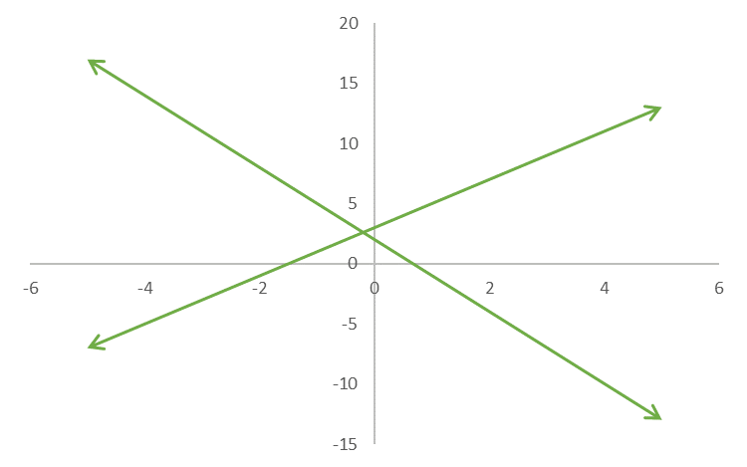
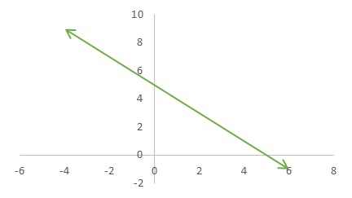
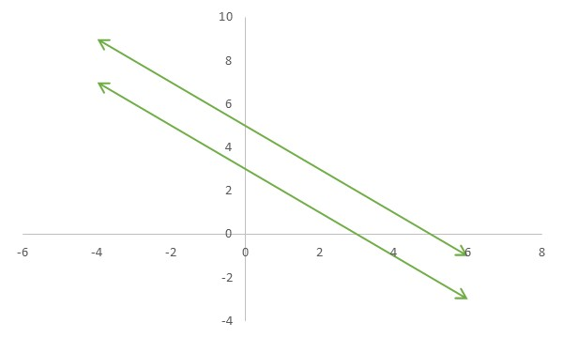
Solution Sets
consistent
inconsistent

Slide 6
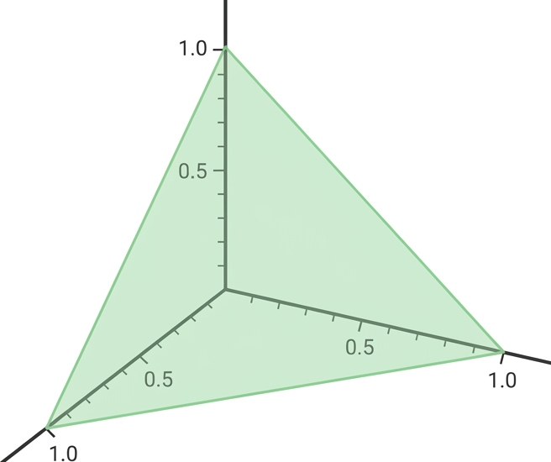
Solution Sets
variables | graph
1 | point
2 | line
3 | plane
> 3 | hyperplane

Slide 7
Solving Systems of Equations
r₃ = r₃ + r₂
+
r₂ = r₂ - 2r₁
r₂ = r₂ + 4r₃

Slide 8
Elementary Row Operations
(Switch) Switch two rows.
(Scale) Multiply all entries in a row by a non-zero number.
(Replace) Replace a row with the sum of itself and a multiple of another row.
Two matrices are row equivalent if there is a sequence of elementary row operations that transforms one into the other.
If the augmented matrices of two linear systems are row equivalent then the two systems have the same solution set.

Slide 9
What’s Next
a formal algorithm
existence and uniqueness

